Slide 1

Collision Detection and Avoidance
using Convex Hull Algorithms
By: Shounak Rangwala, Pratik Mistry, Pranit Ghag,
Vikhyat Dhamija

Slide 2

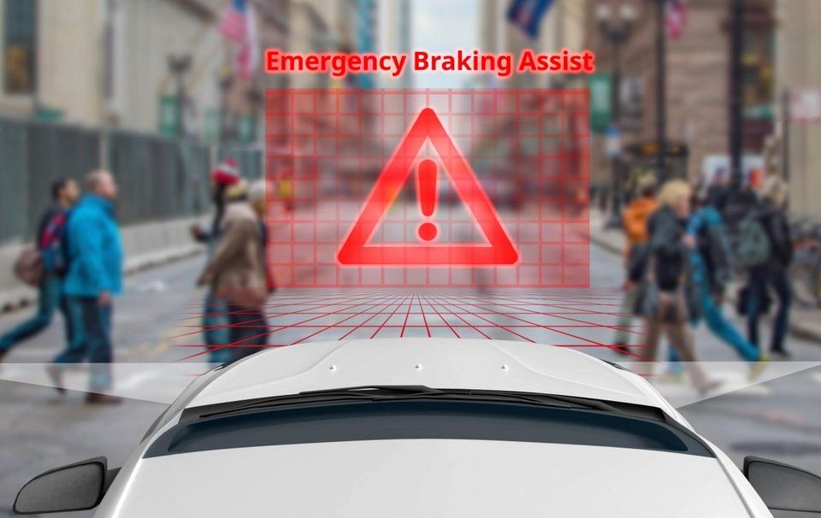
How did we get here?
Collision Detection and Avoidance in Self Driving Cars

Slide 3
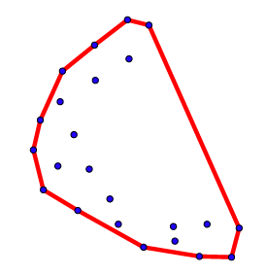
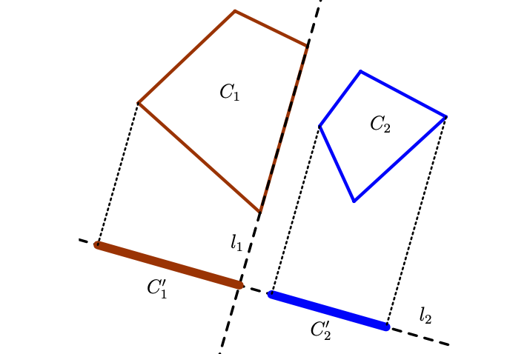
How it is done? - Convex Hull
Convex Hull - It is the smallest convex region which contains all the points from a given set of points
LiDAR points are used as data for Self Driving Cars
We find out the approximate outline of the object - cars,humans or other obstacles
Check for overlap between two different convex hulls - self driving car and obstacle
If Overlap - Collision Detected!!!

Slide 4
How to find Convex Hull?
Computing the convex hull is a problem in computational geometry
Convex Hull Algorithms:
Jarvis March
Quickhull
Graham Scan
Monotone Chain

Slide 5
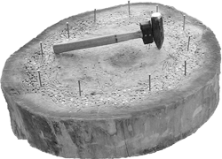
Jarvis March Algorithm
Published by R. A. Jarvis [1973]
Popularly known as Gift Wrapping Algorithm
Simplest algorithm - simulates the act of wrapping a string around the nails on a piece of wood. (Imagine Hammerschlagen)
Jarvis March algorithm has the potential to be the cheapest and the most expensive algorithm when seen from a performance point of view
It is output-dependent (output word used very loosely)

Slide 6
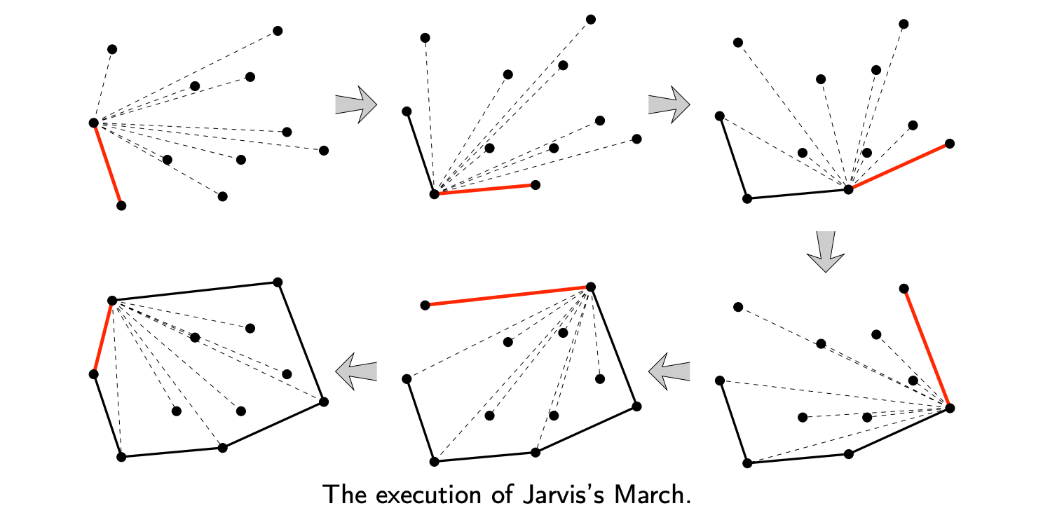
Working procedure of Jarvis March

Slide 7
Complexity Analysis
Average case: O(hN)
For each added point to the hull, the time complexity is O(N)
h is the number of points in the hull
Worst Case: O(N²)
All the N points lie in a circle - makes the entire process happen N times
In practice, h turns out in the order of O(logN) thus resulting complexity is O(NLogN)

Slide 8
The QuickHull Algorithm
Published by C. Bradford Barber, David P. Dobkin, and Hannu Huhdanpää [1996] - Modelled after Quick Sort Algorithm
Working Procedure
Recursively dividing up the points set into 2 halves divided by the line joining the 2 most extreme points
A point from either side is then selected which is at the maximum distance from the dividing ridge and added to the convex hull. A triangle is made using these 3 points. All points inside the triangle are removed from consideration for the convex hull.
The above step is recursively carried forth till there exist no points that can be added to the convex hull

Slide 9
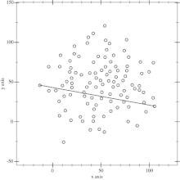
Working procedure for Quickhull

Slide 10
Complexity Analysis
Average case: O(NlogN)
Depends on the starting 2 points of the Quickhull
If we have the leftmost and the rightmost points to start with, the recursive division happens like quicksort
Worst Case: O(N²)
After each division, the number of points reduced are none.i.e the points are arranged in a circle.
Run the entire algorithm N times

Slide 11
Graham’s Scan
Published by Ronald Graham - 1972
One of the first algorithms of computational geometry
Very popular and widely used algorithm
Two important working step:
Sort the set of points according to their polar angle
Scan the points to find the convex hull vertices based on its rotation

Slide 12
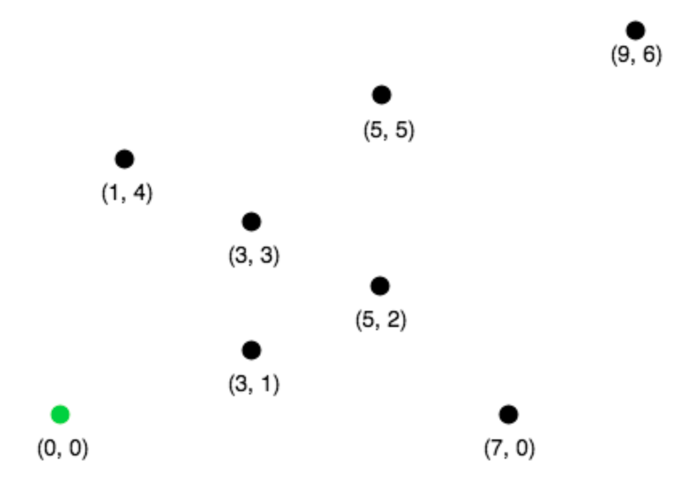
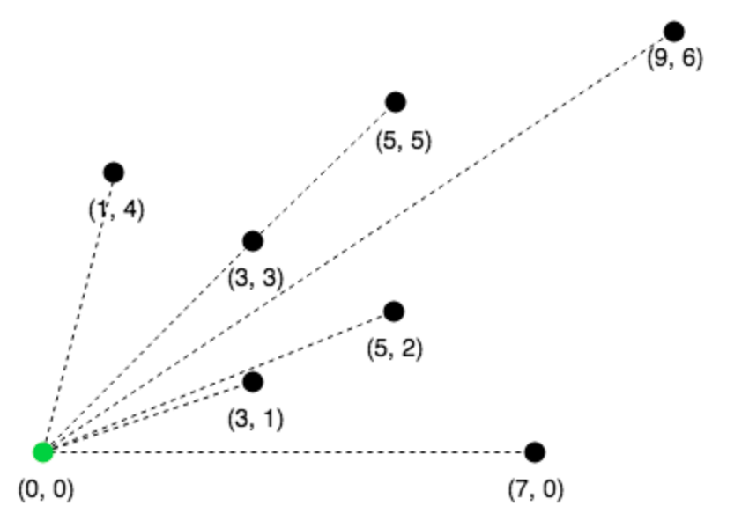
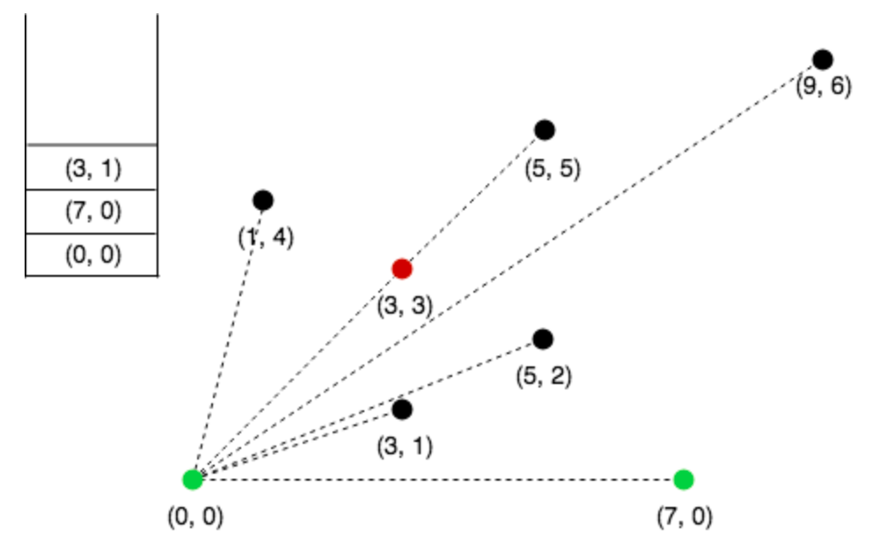
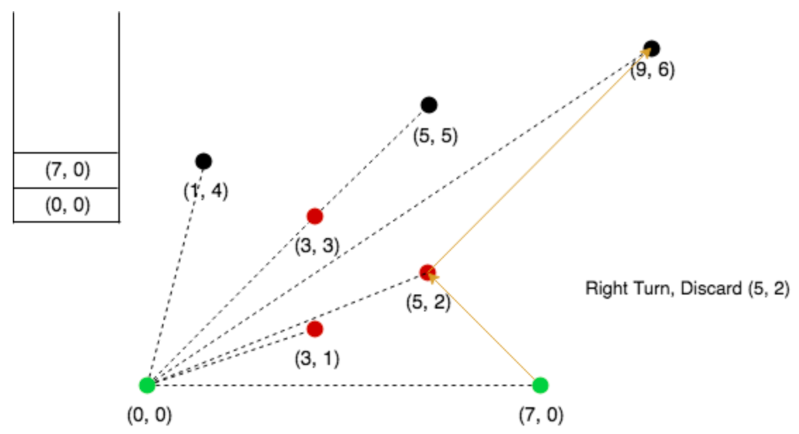
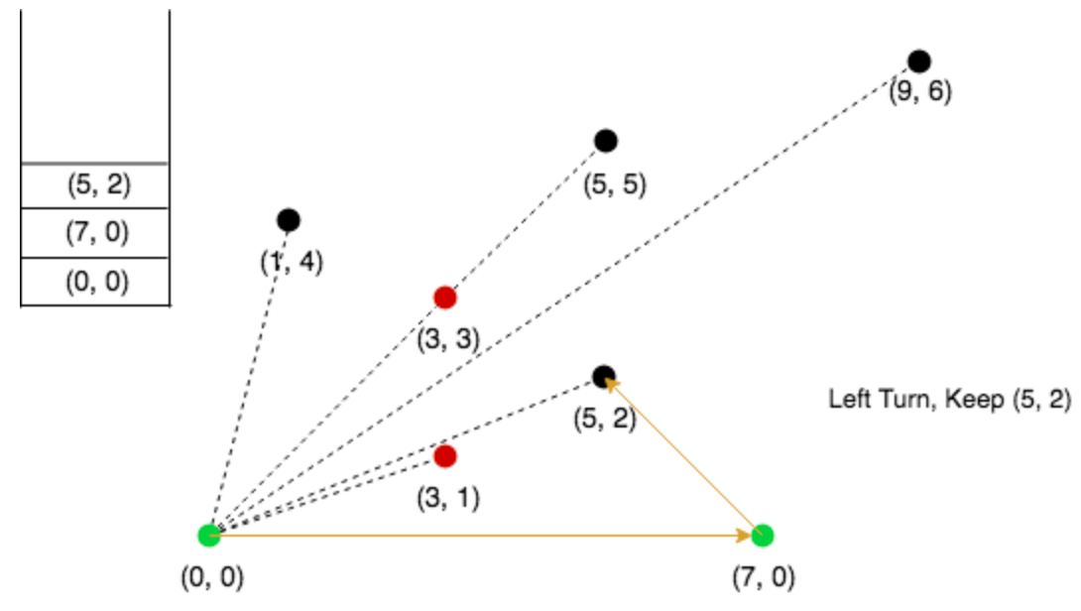
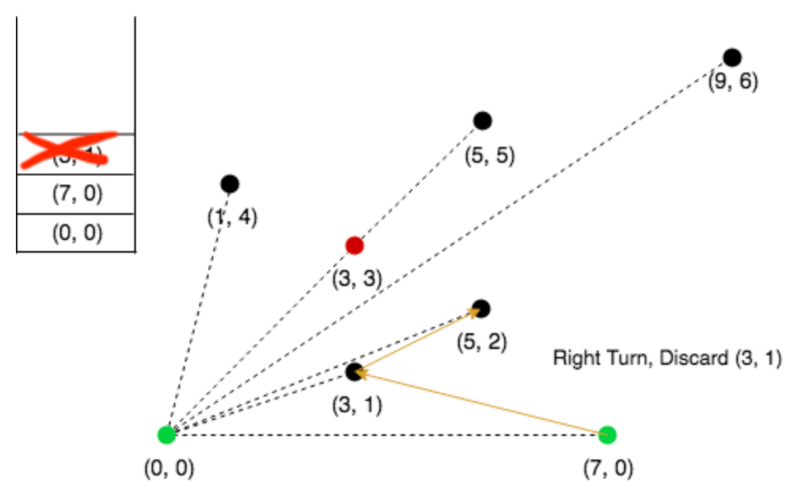
Working Procedure for Graham Scan (1)

Slide 13
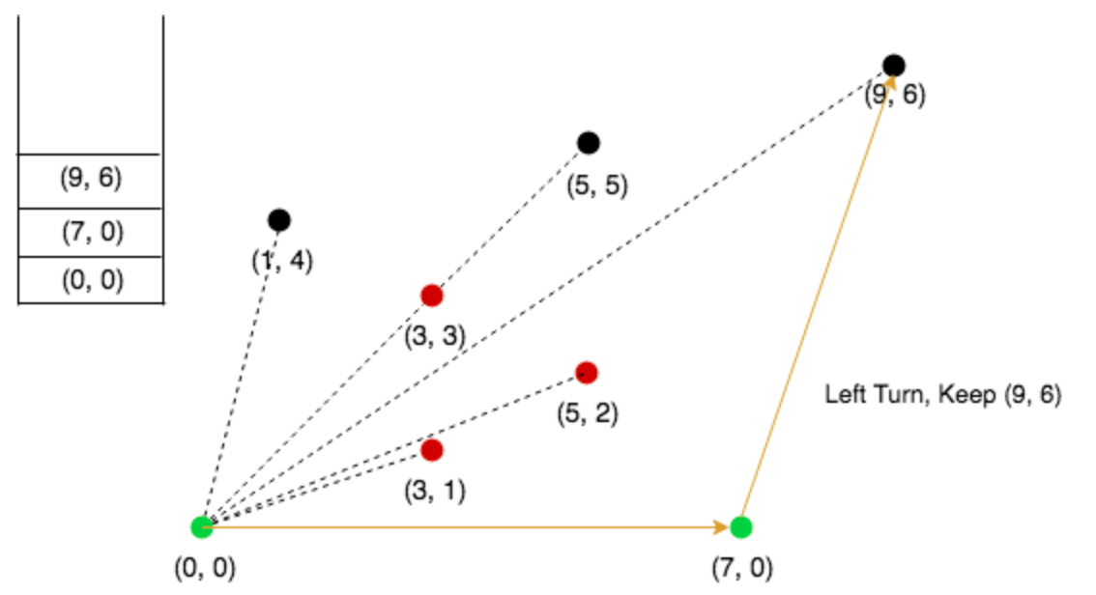
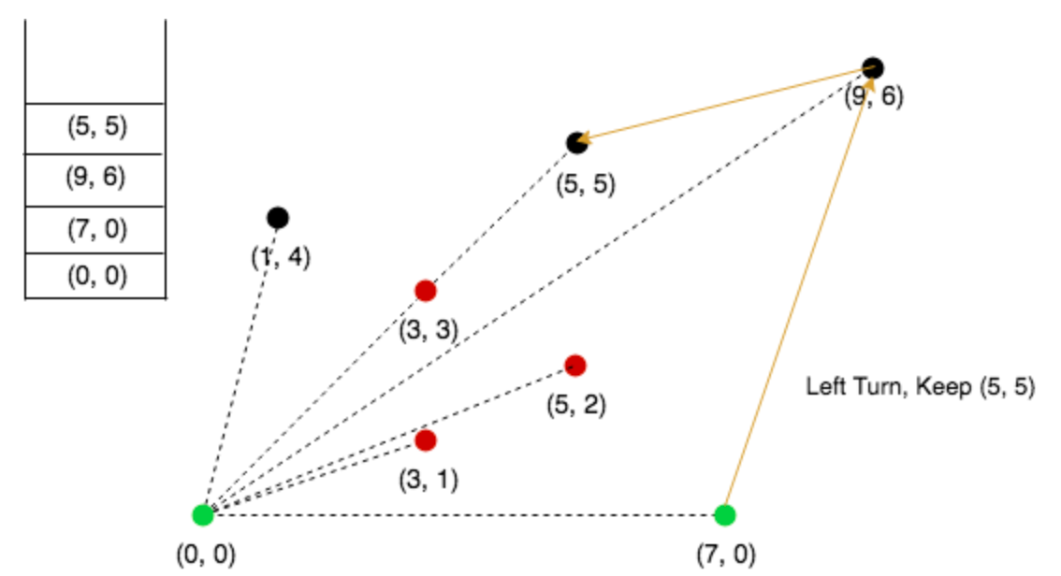
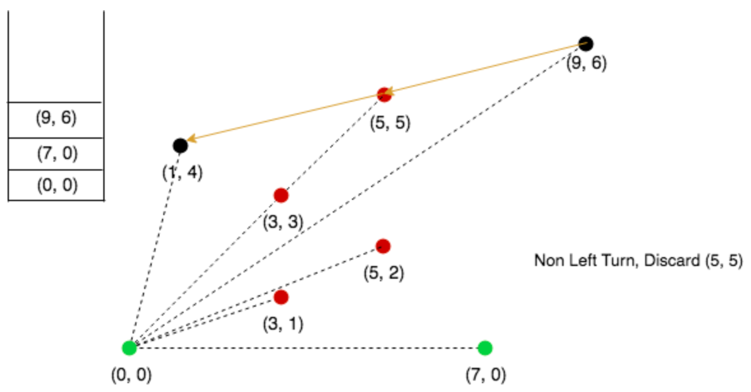
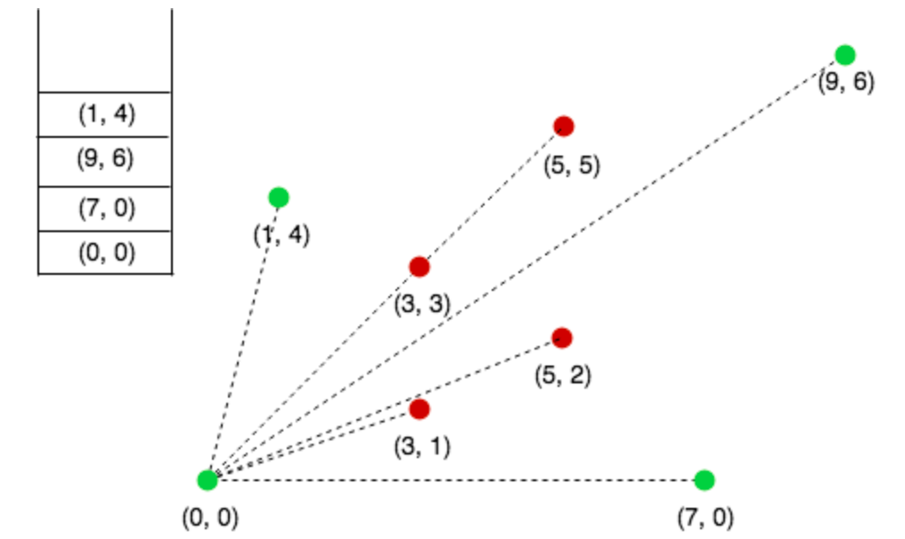
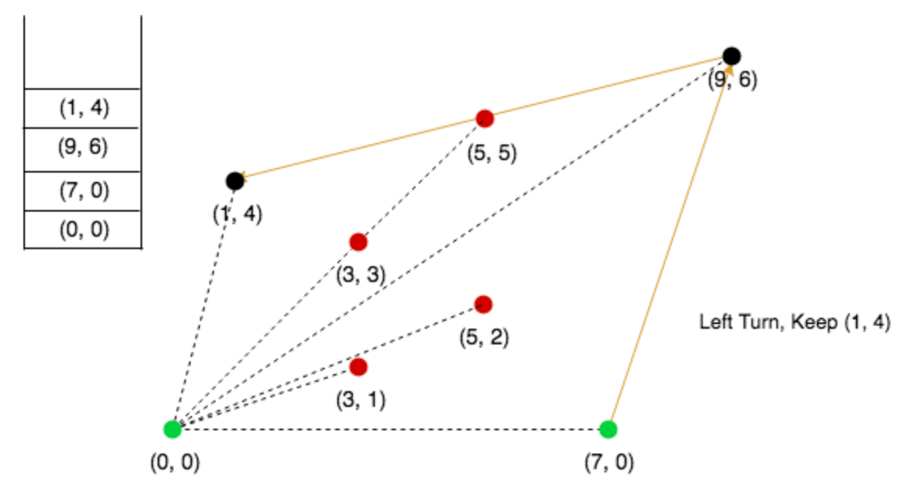
Working Procedure for Graham Scan (2)

Slide 14
Working Procedure for Graham Scan (3)
Find the point with lowest y coordinate (Choose point with smaller x coordinate in case of tie) - P0
Sort other points by polar angles wrt P0 (Consider nearest distance in case of tie)
Create an empty stack S and push points[0] and points[1] to S
Process remaining points as:
Keep removing points from stack while orientation of 3 points is not counterclockwise (or they don’t make a left turn)
Else Push point to S if orientation is counterclockwise
Orientation is determined by comparing slopes of lines P1P2 and P1P3
(x2-x1)(y3-y1) - (y2-y1)(x3-x1)
0 = Collinear, -ve = Right turn or clockwise, +ve = Left turn or counterclockwise

Slide 15
Complexity Analysis
Total running time: O(NlogN)
Runtime of the Graham Scan
O(n) for finding anchor point
O(nlogn) for sorting the points
O(1) constant time for pushing items into the stack
O(n) each point gets pushed once within the for loop
O(n) for popping within the loop, each point gets popped once at most

Slide 16
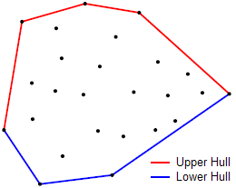
Monotone Chain
Published by A. M. Andrew - 1979
Similar to Graham’s Scan
Important working steps:
Sort the set of points lexicographically
Scan points from left to right to find lower hull
Scan points from right to left to find upper hull
Merge lower and upper hull points

Slide 17
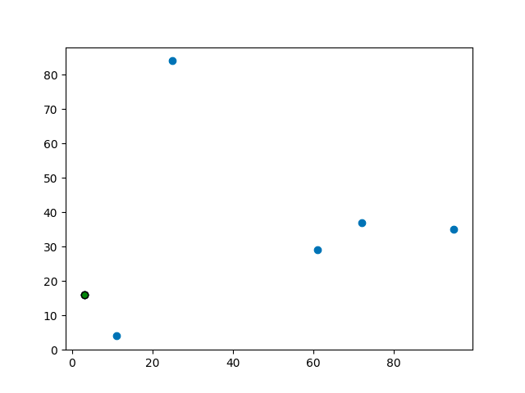
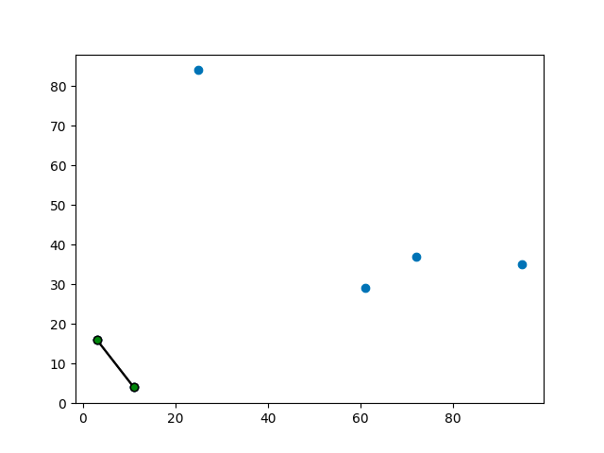
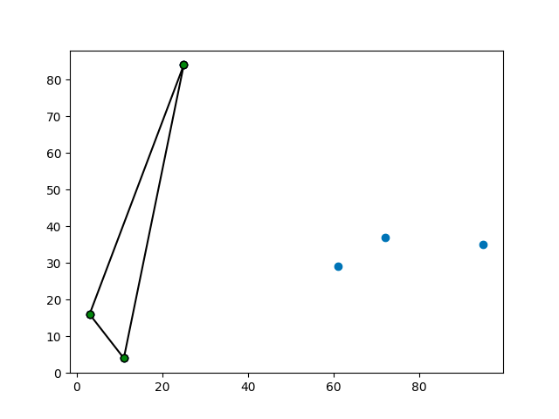
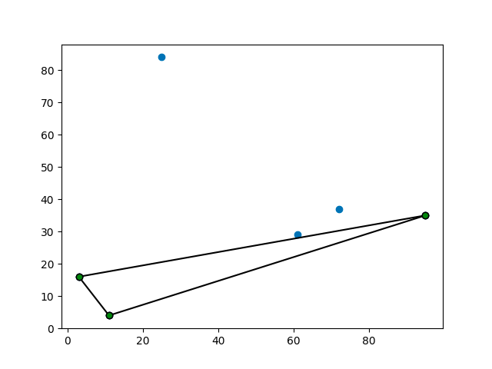
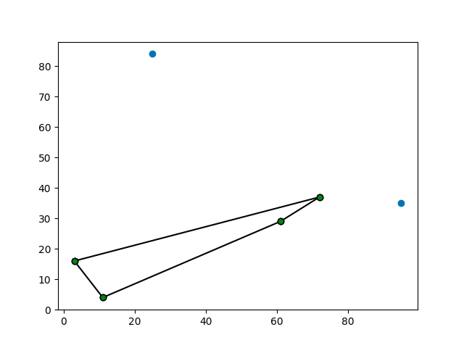
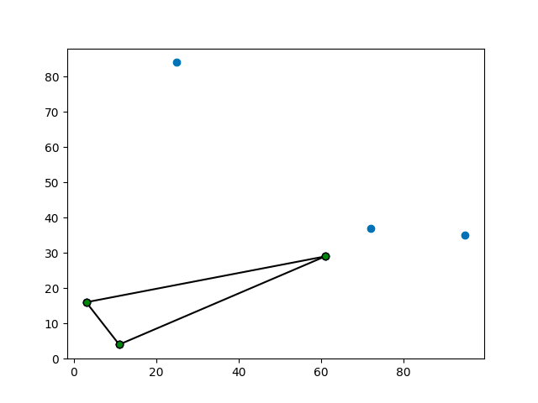
Working Procedure for
Monotone Chain (1)

Slide 18
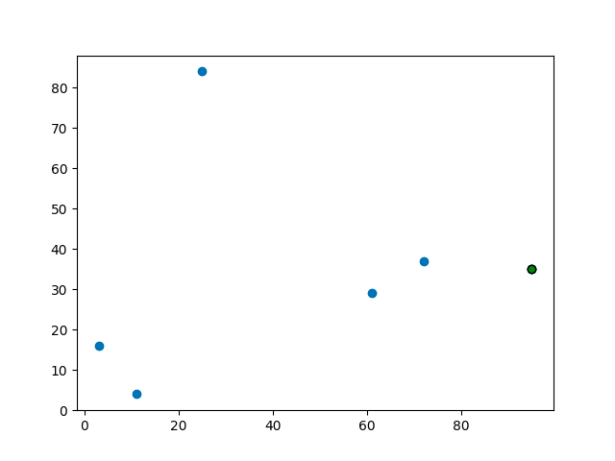
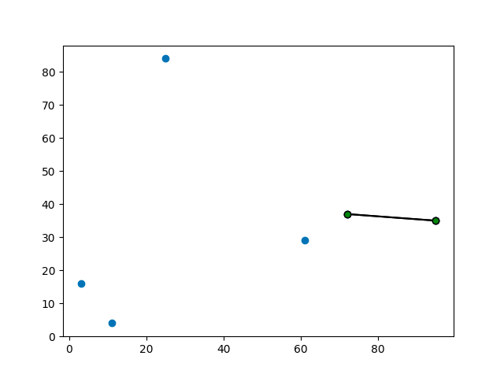
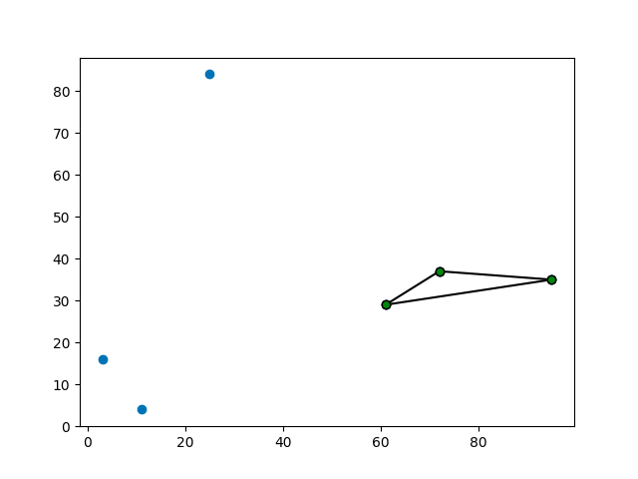
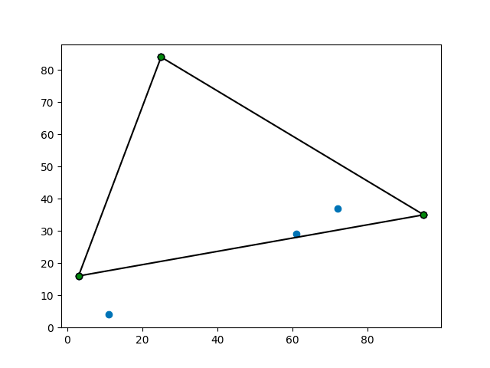
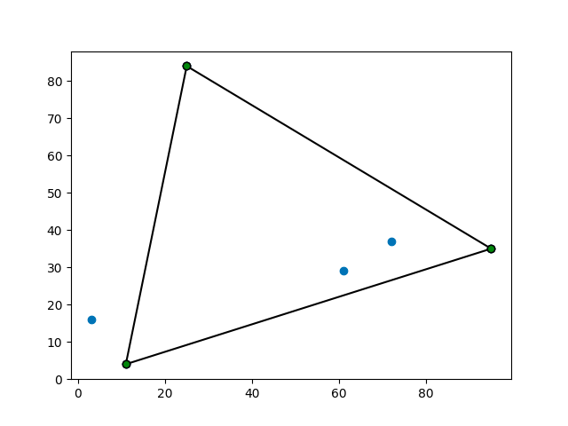
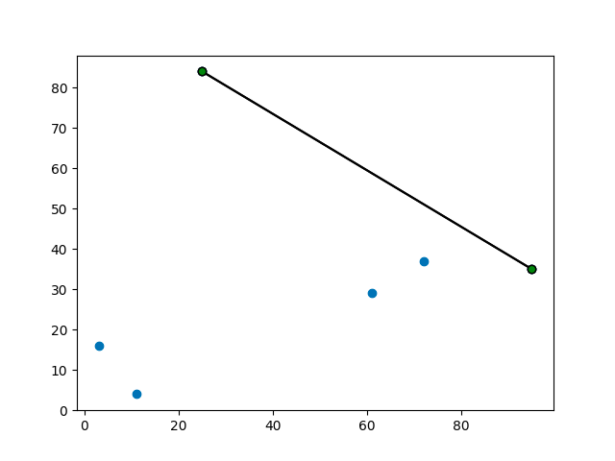
Working Procedure for
Monotone Chain (2)

Slide 19
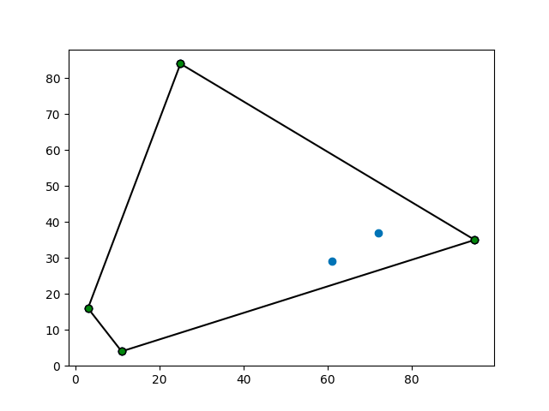
Working Procedure for
Monotone Chain (3)
Sort other points lexicographically (first by x-coordinate, and in case of a tie, by y-coordinate)
Lower Hull: Procedure for lower hull is same as Graham Scan
Upper Hull: Procedure for lower hull is same as Graham Scan
(but reverse the list of points)
Merge Lower and Upper Hull points to get Convex Hull
Orientation is determined by comparing slopes of lines P1P2 and P1P3
(x2-x1)(y3-y1) - (y2-y1)(x3-x1)
0 = Collinear, -ve = Right turn or clockwise, +ve = Left turn or counterclockwise

Slide 20
Complexity Analysis
Total running time: O(NlogN)
Runtime of the Monotone Chain
O(nlogn) for sorting
Combined complexity for lower and upper hull:
2*O(1) constant time for pushing items into stack
2*O(n) each point gets pushed once within the for loop
2*O(n) for popping within the loop, each point gets popped once at most
O(n) to merge lower and upper convex hull

Slide 21
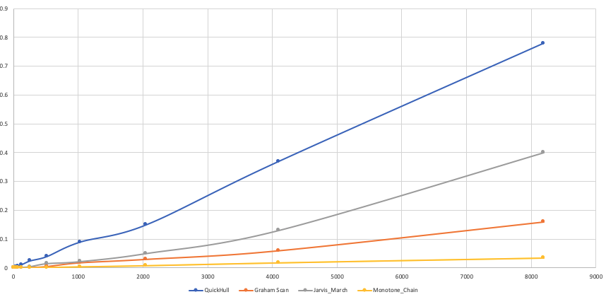
Complexity Analysis Comparison

Slide 22
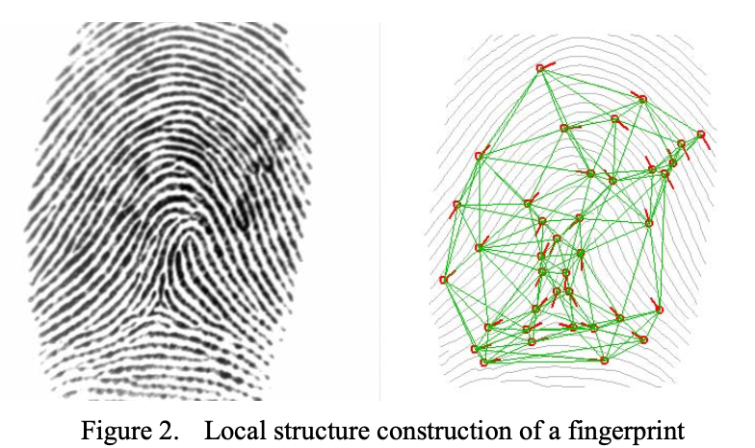
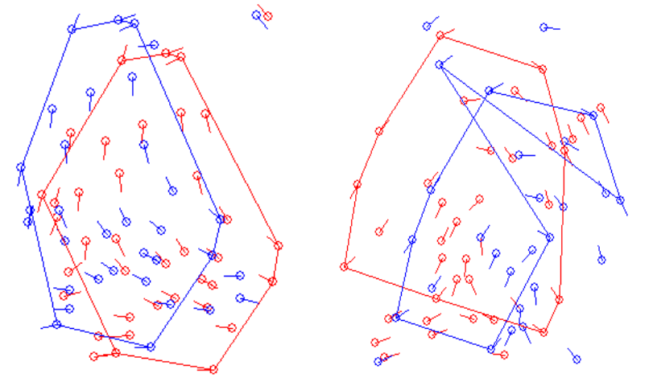
Further scope and applications
Convex hulls are useful for fingerprint matching in security systems
They can be used to identify the deep fake images from real ones
Other applications are pattern recognition, image processing, statistics, geographic information system, game theory, construction of phase diagrams, and static code analysis by abstract interpretation

Slide 23
Thank You

